Slide 1
Ultrasonic Sensor

Slide 2
Hardware
It contains two ultrasonic transducers.
The one acts as a transmitter which converts electrical signal into 40 KHz ultrasonic sound pulses.
The receiver listens for the transmitted pulses. If it receives them it produces an output pulse whose width can be used to determine the distance the pulse travelled.

Slide 3
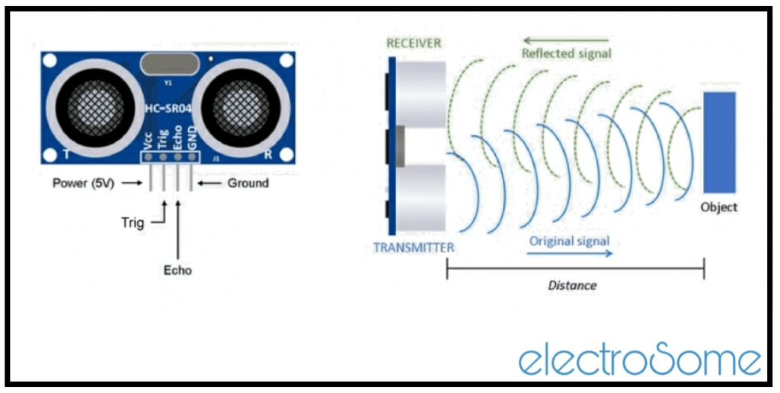

Slide 4
Ultrasonic pinout
VCC:is the power supply for Ultrasonic distance sensor which we connect the 5V pin on the Arduino.
Trig (Trigger): pin is used to trigger the ultrasonic sound pulses.
Echo :pin produces a pulse when the reflected signal is received. The length of the pulse is proportional to the time it took for the transmitted signal to be detected.
GND should be connected to the ground of Arduino.

Slide 5
How does it works?
The functionality of the HC-SR04 ultrasonic sensor can be initiated by giving a 10μS HIGH level signal on the TRIGGER input pin.
Then the module will send out eight ultrasonic burst of 40KHz.
These ultrasonic sound waves travels through the air and if it finds an object or obstacle on its path then it will automatically reflect or bounce back to the receiver of the module.
If the module detects signal back, it will send out a HIGH pulse in ECHO pin for the duration equivalent to the time taken for the ultrasonic waves to come back.

Slide 6
Now the distance of the obstacle can be calculated by using the this time duration.
Speed of the sound in air is about 343 m/s.
V = 0.0343 cm/μS
Time = Distance / Speed
Distance = Speed * Time
D = 0.0343 * Time
Since the ultrasonic burst travels towards the obstacle and reflects back to the sensor, we have twice the distance. So actual distance, d = D/2.
d = (0.0343 * t)/2

Slide 7
Program
const int trigPin=2;
const int echoPin=6;
long duration;
int distance;
Void setup(){
pinMode(trigPin,OUTPUT);
pinMode(echoPin,INPUT);
Serial.begin(9600);
}

Slide 8
Void loop(){
digitalWrite(trigPin,LOW);
delayMicroseconds(2);
digitalWrite(trigPin,HIGH);
delayMicroseconds(10);
digitalWrite(trigPin,LOW);
duration=pulseIn(echoPin,HIGH);
distance=duration*0.0343/2;
Serial.print(“Distance:”);
Serial.println(distance);
}

Slide 9
Limitations
This sensor does work properly when
The distance between the sensor and the object/obstacle is more than 13 feet.
The object has its reflective surface at a shallow angle so that sound will not be reflected back towards the sensor.
The object is too small to reflect enough sound back to the sensor.
some objects with soft, irregular surfaces (such as stuffed animals) absorb rather than reflect sound and therefore can be difficult for the HC-SR04 sensor to detect.

Slide 10
Thank you…

